Slide 1

Presentation - Linux Fundamentals
Linux Fundamentals

Slide 2
What will we Learn ?
1. Introduction to Linux
2. Architecture of Linux
3. Basic Linux Commands
4. Overview of Linux Distro
5. Overview to Shell
6. Overview to VIM editor
7. Overview of SSH

Slide 3

What is Linux ?
Linux is an Open Source Operating System modelled on Unix, and developed in C language

Slide 4
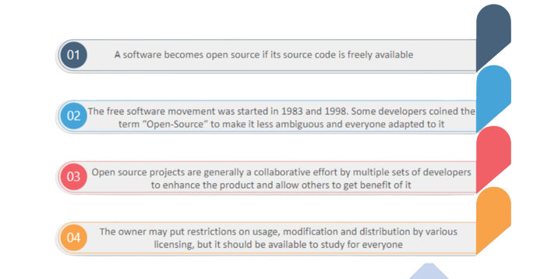
Open Source
Open Source

Slide 5
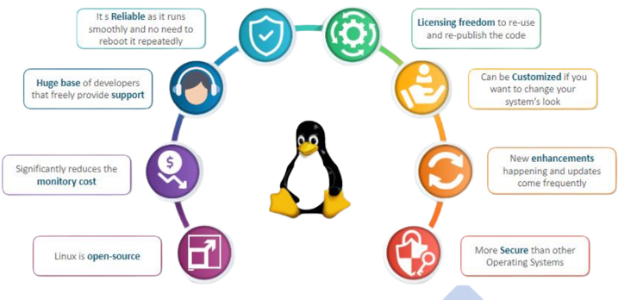
Features of Linux
Features

Slide 6
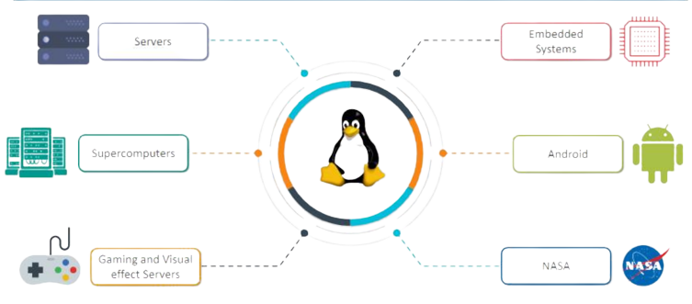
Where is Linux Used ?
Uses :

Slide 7
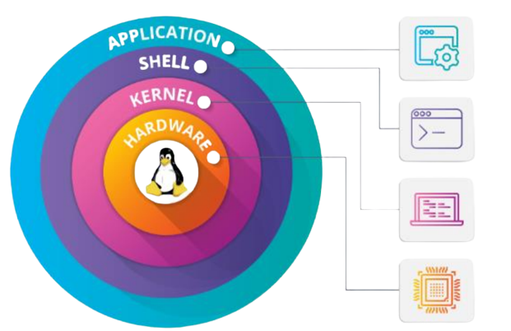
Architecture of Linux OS
Architecture :

Slide 8
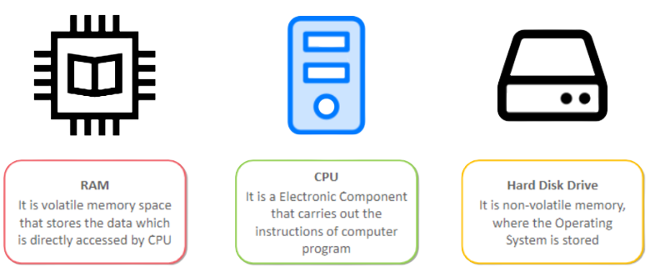
Hardware
Hardware part of architecture includes all the peripheral devices. For Example : CPU, RAM, Hard Disk Drive, etc

Slide 9
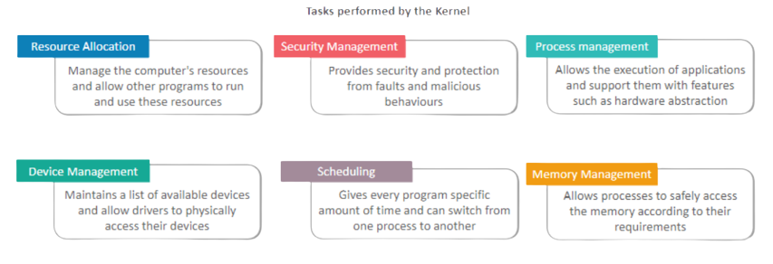
Kernel
The kernel is the interface between the applications and the actual process done at the hardware level.

Slide 10




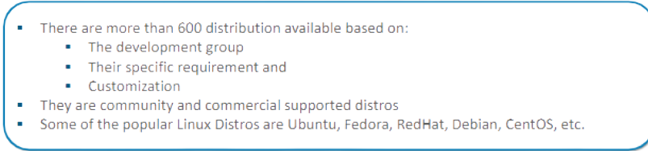
What is Linux Distribution ?
It is an Operating system having linux kernel and GNU Tools packaged with some more application.

Slide 11
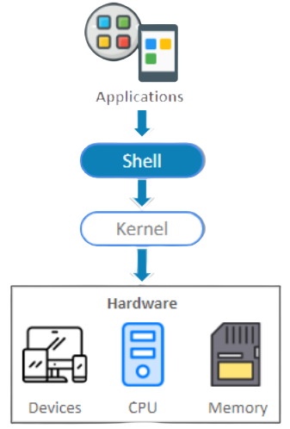
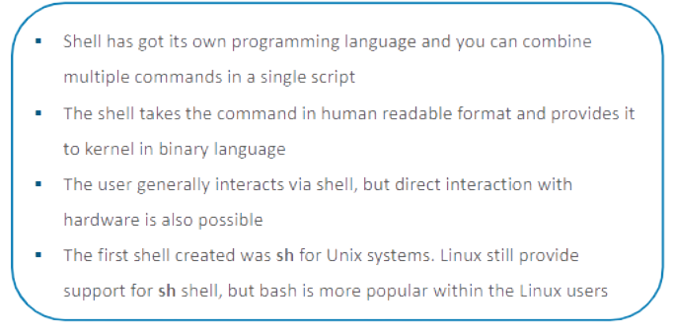
Shell
The Shell is the interface which takes user-commands and sends it to the kernel

Slide 12

Distinguishing Factors For Linux Distro
Enterprise users or home users
Home user distro has user-friendly GUI and it is easy to use
Enterprise edition gives more importance to performance
Hardware support
Most of the distros are portable to multiple hardware, but some of
them are designed for specific vendors
Designed for Servers, Desktops and Embedded devices
Server distro generally don't have a GUI
Some of the packages of server distro are different from desktop distro

Slide 13
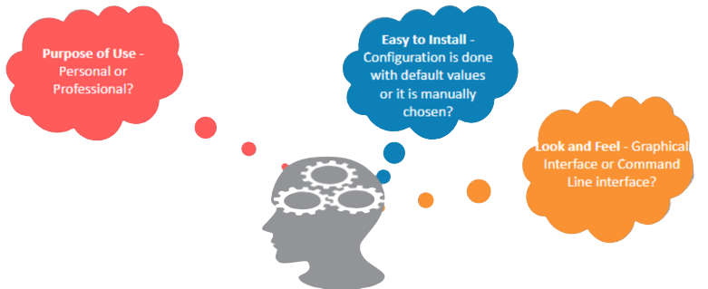
How to choose Distro?
The Distro should be chosen based on the requirement of the user
For this training it is recommended to use ubuntu

Slide 14
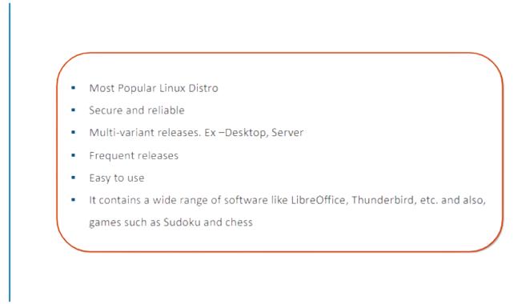
Ubuntu
.

Slide 15
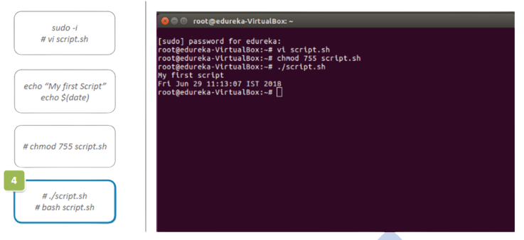
Creating A Shell Script
.

Slide 16
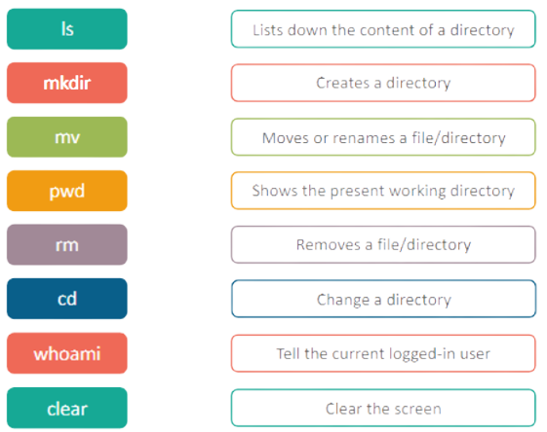
Basic Linux Commands
.

Slide 17
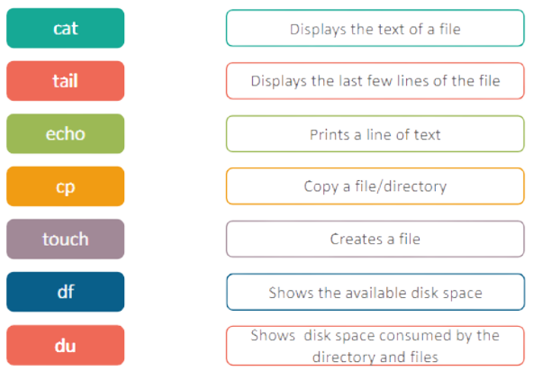
Basic Linux Commands
.

Slide 18
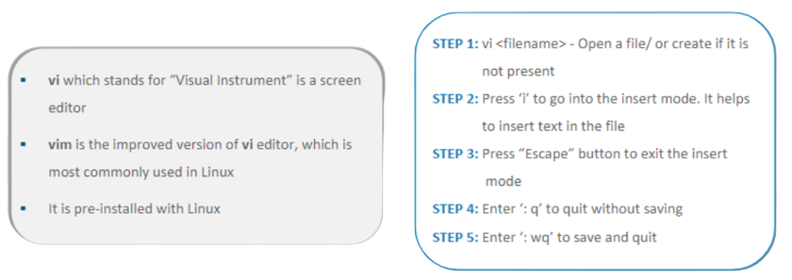
Vim Editor
.

Slide 19
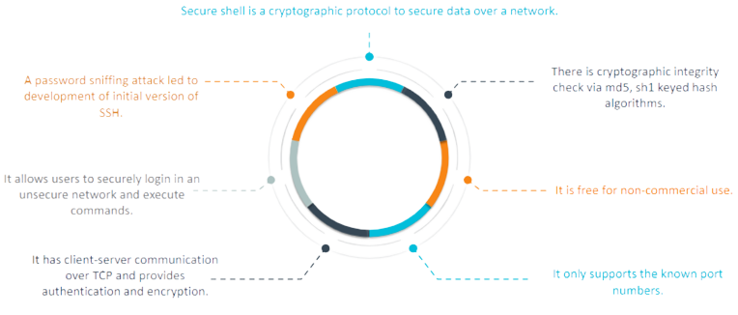
SSH

Slide 20
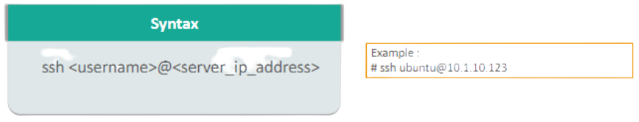
SSH Session
A client-server model is used during establishment of connection between two parties and encrypt the data between them
A SSH session works in two stages:
To sync the encryption to be used for any further communication
To authenticate the user for access rights to be given
The server waits on the configured port for connections
The client initiates the TCP handshake with the server

